Slide 1
Eigenvalues and Eigenvectors
MATH 4341 : Linear Algebra
Aashnan Rahman
Junior Lecturer
Department of Computer Science and Engineering (CSE)
Islamic University of Technology

Slide 2
Recap
Linear Transformation
A function between two vectorspaces that preserves the operation of vector addition and scalar multiplication.
Span
The collection of all possible linear combinations of some vectors.

Slide 3
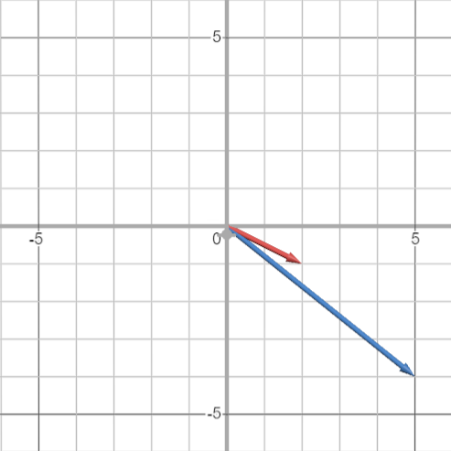
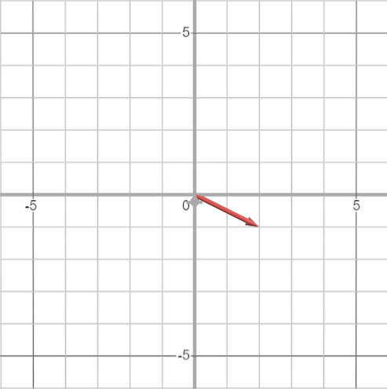
Eigenvalues and Eigenvectors
3 1
0 4
2
–1
5
–4
=

Slide 4
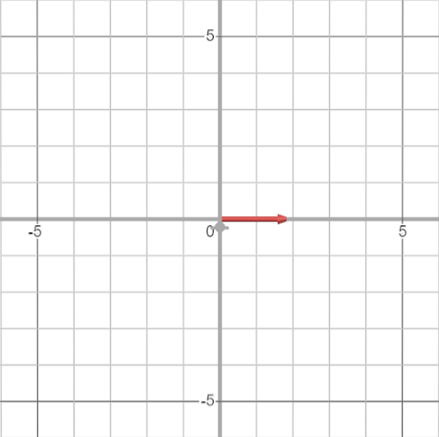
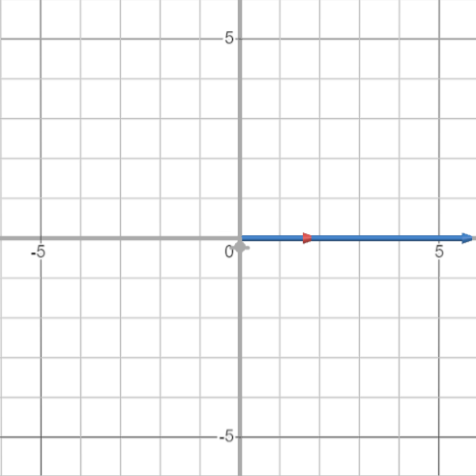
Eigenvalues and Eigenvectors
3 1
0 4
2
0
6
0
=

Slide 5
Eigenvalues and Eigenvectors
Some vectors will remain in its span even after being multiplied by a matrix, such vectors are known as Eigenvectors.

Slide 6
Eigenvalues and Eigenvectors
Eigenvectors
The vectors which stays on the same span (stretched/squeezed) after transformation.
Eigenvalues
The factors by which the eigenvectors get squeezed or stretched.

Slide 7
Eigenvalues and Eigenvectors
3 1
0 4
2
0
6
0
2
0
=
=
3
Eigenvector
Eigenvalue

Slide 8
Eigenvalues and Eigenvectors
Eigenvalues have very strong relationship with determinants of a matrix.
Eigenvalues can be negative (Flipped orientation).

Slide 9

Eigenvalues and Eigenvectors
Eigenvector
Eigenvalue

Slide 10


Eigenvalues and Eigenvectors
INCONSISTENCY !!!!

Slide 11



Eigenvalues and Eigenvectors
Matrix
non–zero
vector

Slide 12



Eigenvalues and Eigenvectors
is a non–zero vector as it is squeezed or stretched by .
is such a matrix which squeezes the space of a non-zero vector into a lower dimensional space.

Slide 13


Eigenvalues and Eigenvectors
How to solve

Slide 14



Eigenvalues and Eigenvectors
Example 1:

Slide 15



Eigenvalues and Eigenvectors
Example 2:

Slide 16



Eigenvalues and Eigenvectors
How to get Eigenvalues and Eigenvectors?
Compute .
2. Find the roots of polynomials of .
3. For each eigenvalue , solve to find eigenvectors.

Slide 17
Eigenvalues and Eigenvectors
Relationship between Eigenvalue and Determinants
no. of Eigenvalues = no. of Eigenvectors
For n x n matrix, product of Eigenvalues = Determinant.
Sum of n Eigenvalues = Trace (Sum of n diagonal entries)

Slide 18


Eigenvalues and Eigenvectors
Example 2:

Slide 19
Eigenvalues and Eigenvectors
If ‘kI’ is added to any matrix
The eigenvalue is increased by k.
The eigenvectors remains same.

Slide 20


Eigenvalues and Eigenvectors
If ‘kI’ is added to any matrix

Slide 21


Eigenvalues and Eigenvectors
+3
+3

Slide 22




Eigenvalues and Eigenvectors
Common Misconception
This is true only when the eigenvectors are same for both the cases.
Not true because the eigenvector x might not be same for A and B.

Slide 23





Eigenvalues and Eigenvectors
But why? how?

Slide 24


Eigenvalues and Eigenvectors
Because eigenvectors aren’t same.

Slide 25


Eigenvalues and Eigenvectors
Example 3:
Why?
A is a rotation matrix

Slide 26
Eigenvalues and Eigenvectors
“The more symmetric the matrix is,
the better our eigenvalues will be”

Slide 27


Eigenvalues and Eigenvectors
Example 4:
Why?
Only one independent Eigenvector. (same eigenvalues)

Slide 28
Eigenvalues and Eigenvectors
For triangular matrices, how many eigenvalues are we supposed to get?
For n x n matrix,
Number of eigenvalues depend on
Size of the given matrix
Symmetry of the given matrix

Slide 29




Eigenvalues and Eigenvectors
Example 5:
Solution

Slide 30

Extras
Generalized Characteristics of Eigenvalues and Eigenvectors

Slide 31
Projection matrices
Reflection matrices
Rotation matrices
Only two possible values of 𝜆 = 0,1.
Only two possible values of 𝜆 = +1, –1.
Complex Conjugate Form

Slide 32

Eigenvalues and Eigenvectors
Little hack:

Slide 33
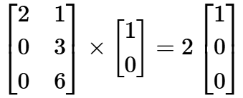
Eigenvalues and Eigenvectors
Eigenvectors are the vectors that remain in its own span after being multiplied with a matrix.
is not an eigenvalue of A since and have different spans (in different dimensions).

Slide 34


Slide 35
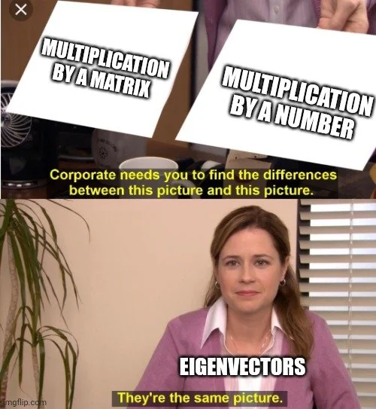

Slide 36
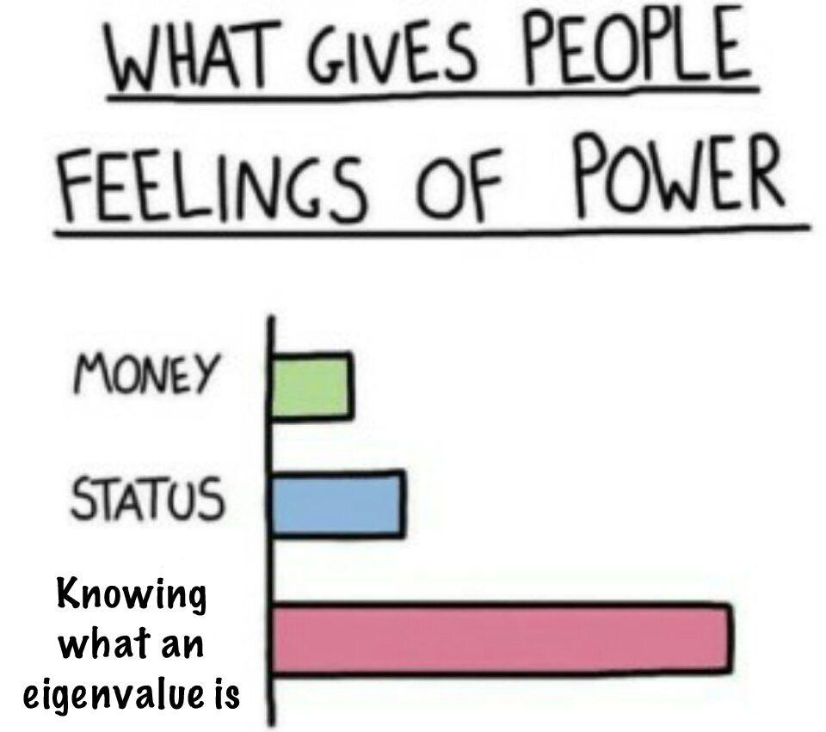

Slide 37
References
Gilbert Strang (L21)
3blue1brown

Slide 38
¡THANKS!

